Slide 1
Iceland
Blue = Ocean Surrounding White = Snow & Ice Fields Red = Volcanic Fires

Slide 2
Iceland
Population of Iceland = 322,000 Population of Seattle = 684,000

Slide 4
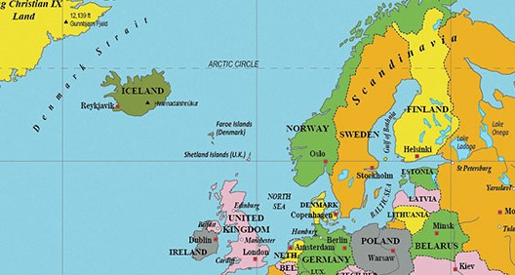
Vikings!
Norsemen first settled Iceland.
Looking for more farmland.
Norsemen = “North-men” from Norway, Sweden & Denmark
I Viking = gone adventuring
Viking Boats have flat bottoms.
Allowed them to float right onto a beach or shoreline.
Round bottom boats must remain in deep water

Slide 5
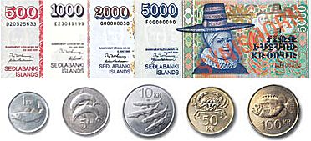
Icelandic króna
110 krona (ISK) = $1 U.S.
1 gallon of milk = 534 krona ($4.85 in U.S.)
A small coca cola = 285 krona ($2.59 in U.S.)
Cheerios = 770 krona ($6.99 in U.S.)

Slide 6
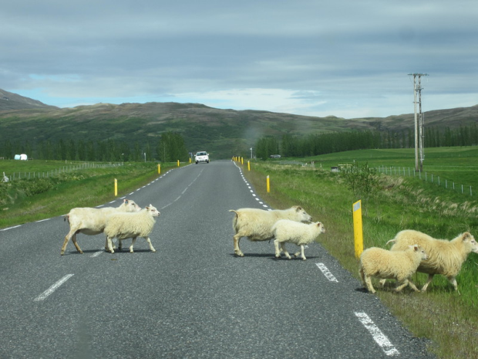
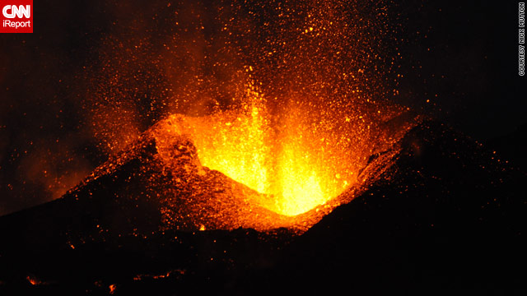
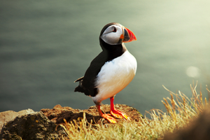
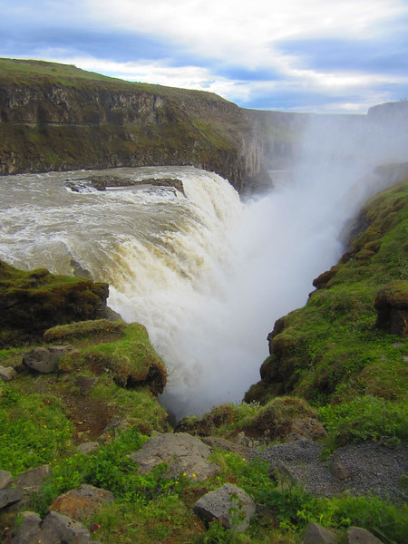
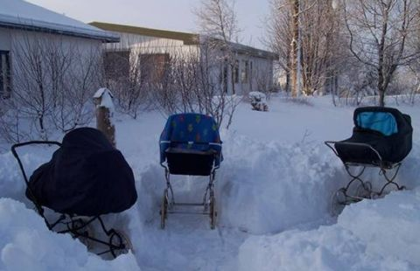
Iceland has….
Volcanos
Geysers
Waterfalls
Puffins
Sheep
Swimming Pools
Babies napping outside!

Slide 7
Iceland does NOT have
Forests
Polar Bears
McDonalds
Mosquitos
Pet snakes, lizards or turtles

Slide 8
Taste of Icelandic Food
Fermented Shark
Gravlax
Wind Dried Fish
Smoked Lamb
Seaweed

Slide 9
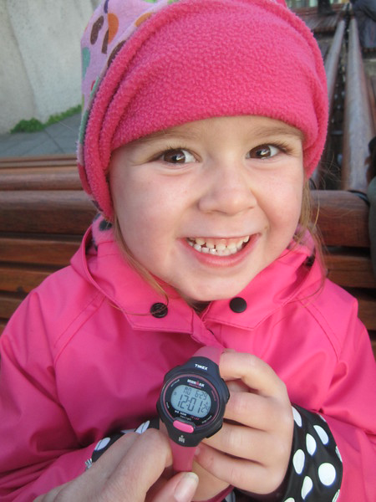
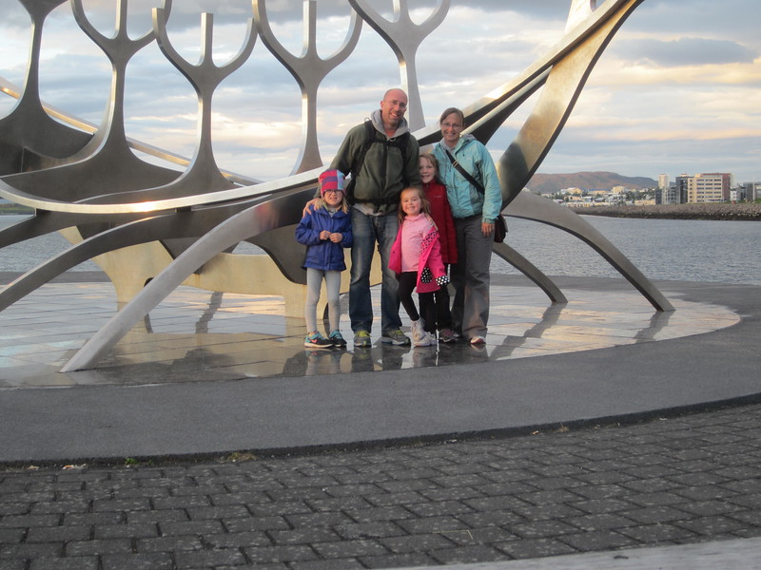
Midnight Sun – 21 hours of daylight

Slide 10
December = 4 ½ hours of daylight
Sunrise is 11am (Almost lunchtime for you at Puesta!) Sunset is 3:38pm ( That is the end of your school day!)

Slide 11
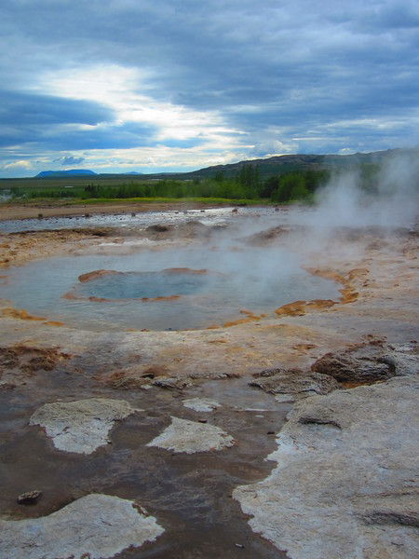
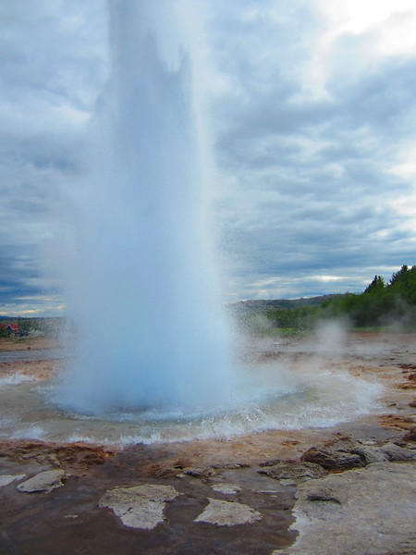
Strokkur Geysir
Erupts every 6-10 minutes
Spouts up to 100 feet!

Slide 12
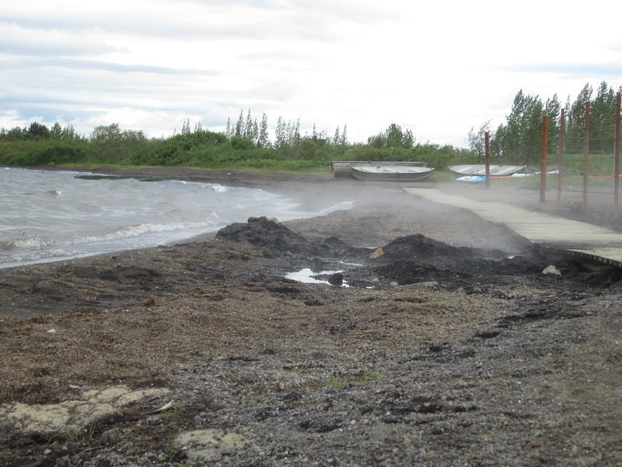
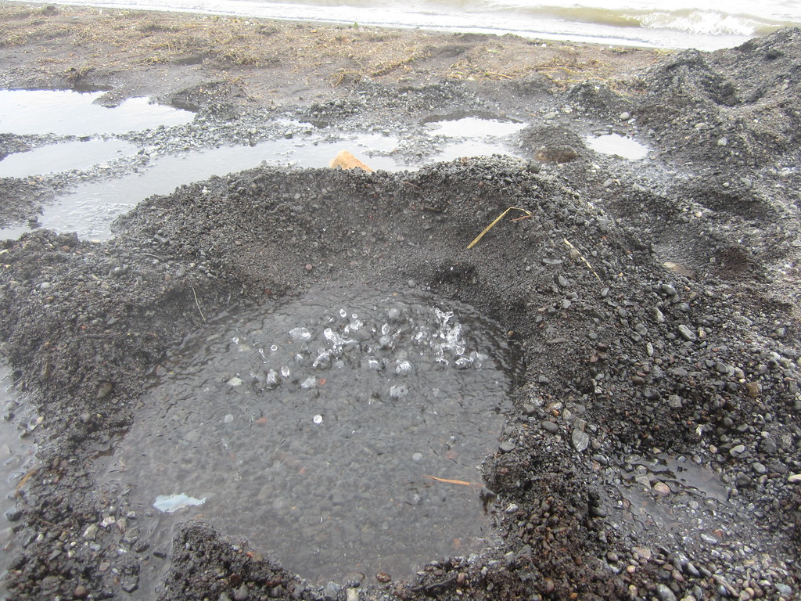
Geothermal Lakes!
Rye Bread is buried & baked in the ground at the end of this bridge.
We are cold & wearing hats!
But the lake water is boiling HOT!

Slide 13
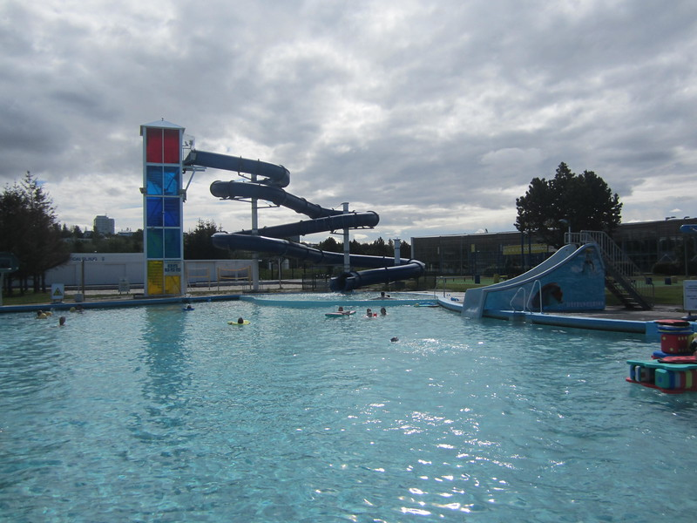
Geothermal Swimming Pools
Outdoor swimming pools are
open Year Round
Cost for family of 5 = 2200 krona ($20 US)
Wading Pool Temperature = 89 degree
Main Pool Temperature = 84 degrees
Hot tub Temperature = 100 – 111 degrees

